Slide 1
日志&ES translog
詹玉林
2019-7-1

Slide 2
日志
日志的分类：
1、外部日志
跟踪、查看运行情况，了解当前状态
文本类型，便于人工查看
2、内部日志
用于特殊用途
通常是二进制结构，可通过特殊工具查看

Slide 3
日志
我们在这里主要讨论的是第二种类型的日志。
在关系型数据库中该类型日志主要有三种用途：
用于数据库事务回滚
用于灾难恢复
用于远程复制
在ES中主要有两种用途：
用于灾难恢复
用于远程复制

Slide 4
ES translog：
Because Lucene commits are too expensive to perform on every individual change, each shard copy also has a transaction log known as its translog associated with it.
All index and delete operations are written to the translog after being processed by the internal Lucene index but before they are acknowledged.
In the event of a crash, recent transactions that have been acknowledged but not yet included in the last Lucene commit can instead be recovered from the translog when the shard recovers.

Slide 5
ES translog：
Primary Terms
These primary terms are incremental and change when a primary is promoted. Same as term in RAFT.
Sequence Numbers
We added a simple counter and started issuing each operation a sequence number from that counter
Local and Global Checkpoints
The global checkpoint is a sequence number for which we know that all active shards histories are aligned at least up to it.
The local checkpoint is a sequence number for which all lower sequence numbers were processed on the shard copy.

Slide 6
ES translog：

Slide 7
ES translog：
The First Benefit: Faster Recovery
index.translog.retention.size: defaults to 512mb. If the translog grows past this, we only keep this amount around.
index.translog.retention.age: defaults to 12h. We don't keep translog files past this age
The Next Benefit: Cross Cluster Replication
Disaster Recovery (DR) / High Availability (HA)
Data Locality
Centralized Reporting

Slide 8
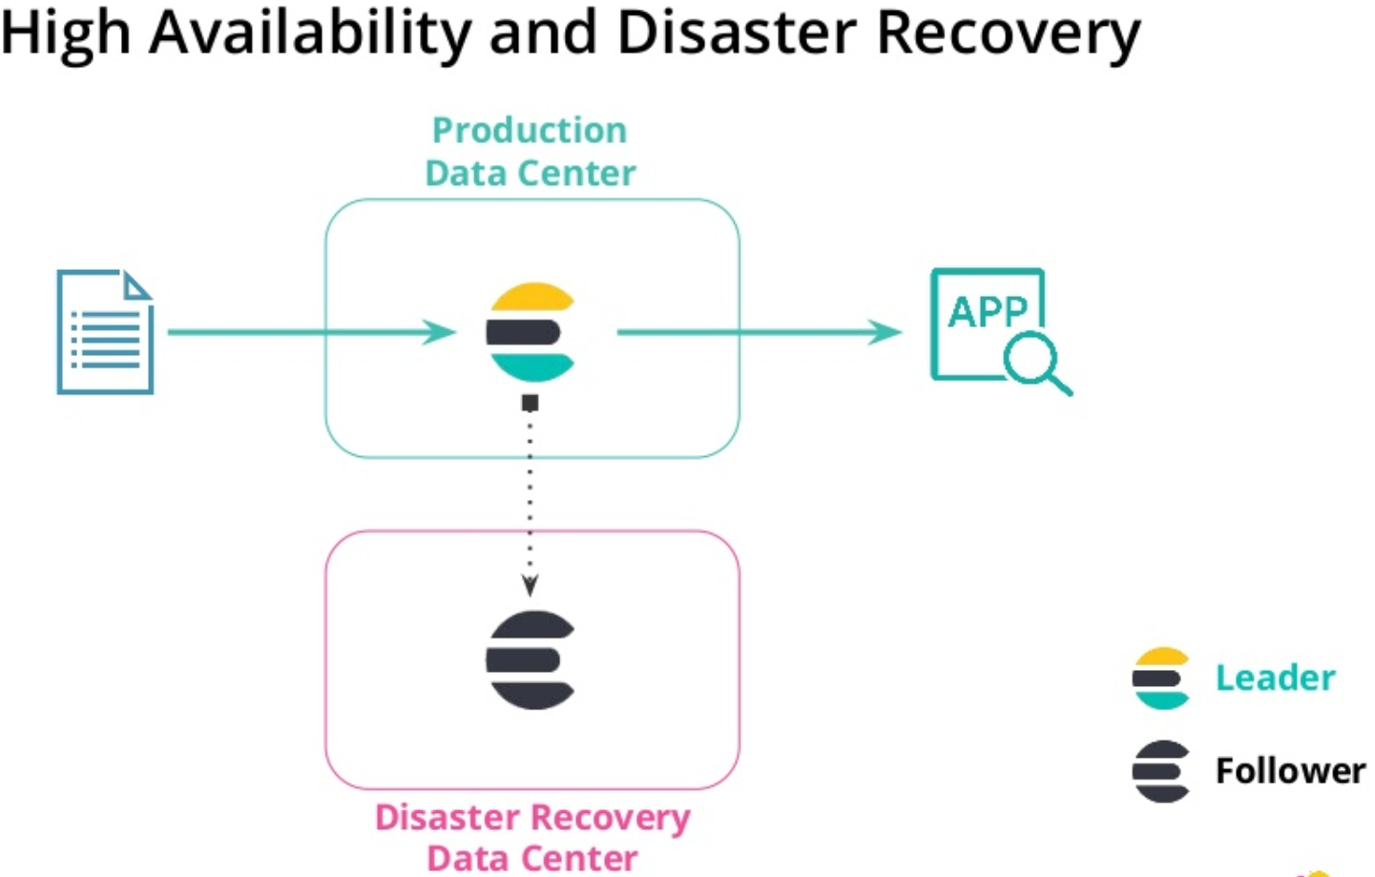
ES translog：

Slide 9
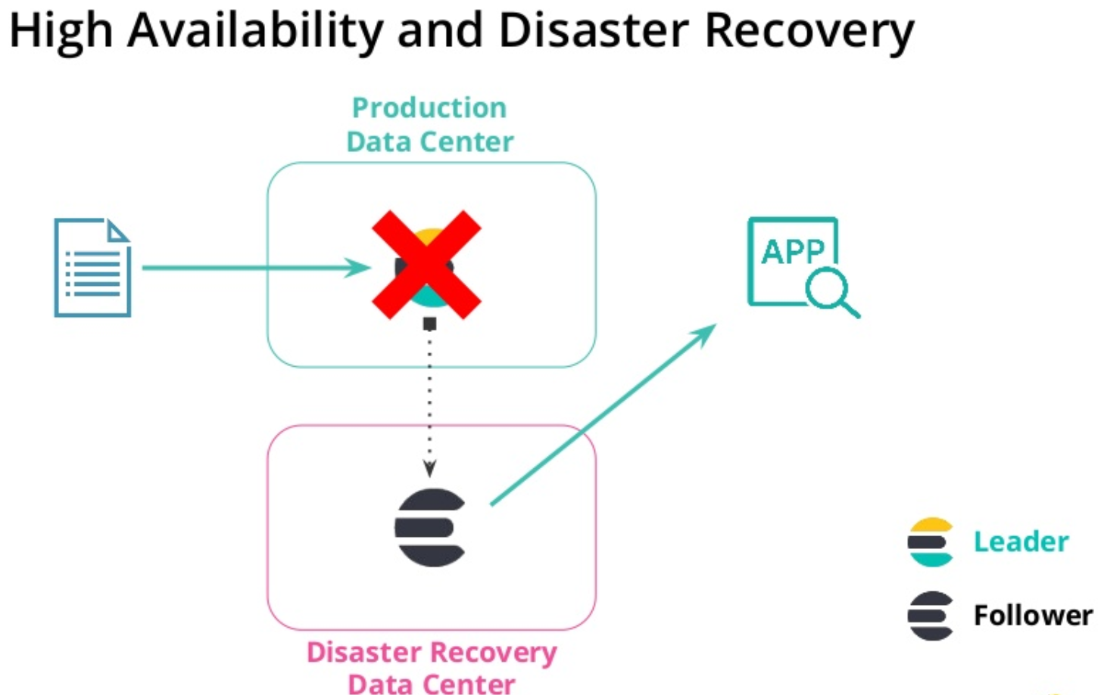
ES translog：

Slide 10
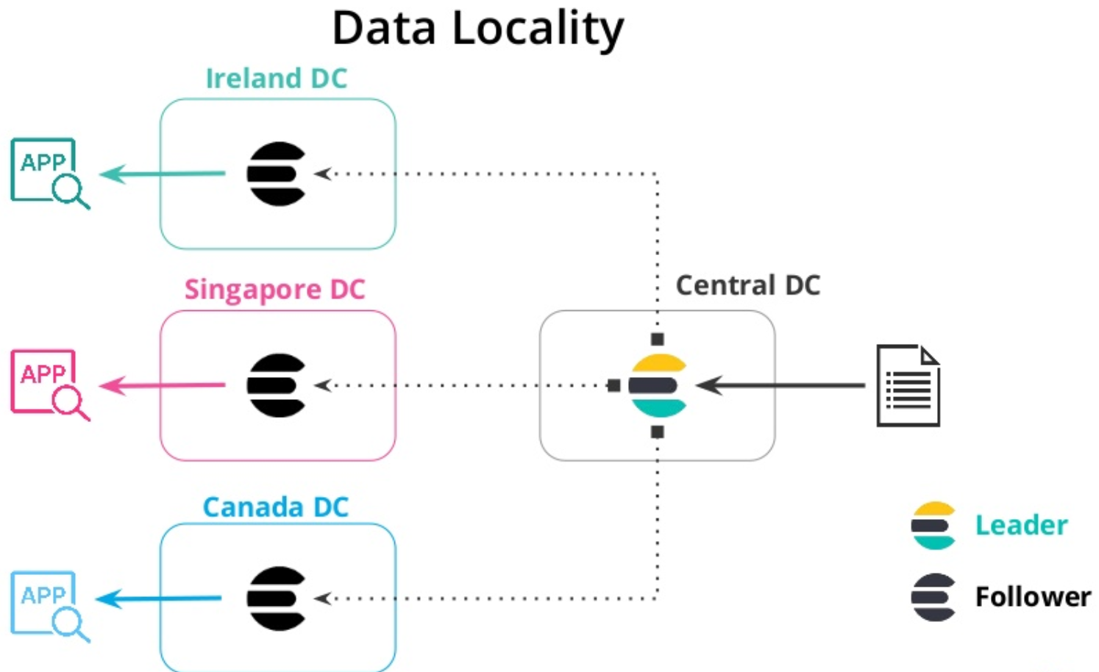
ES translog：

Slide 11
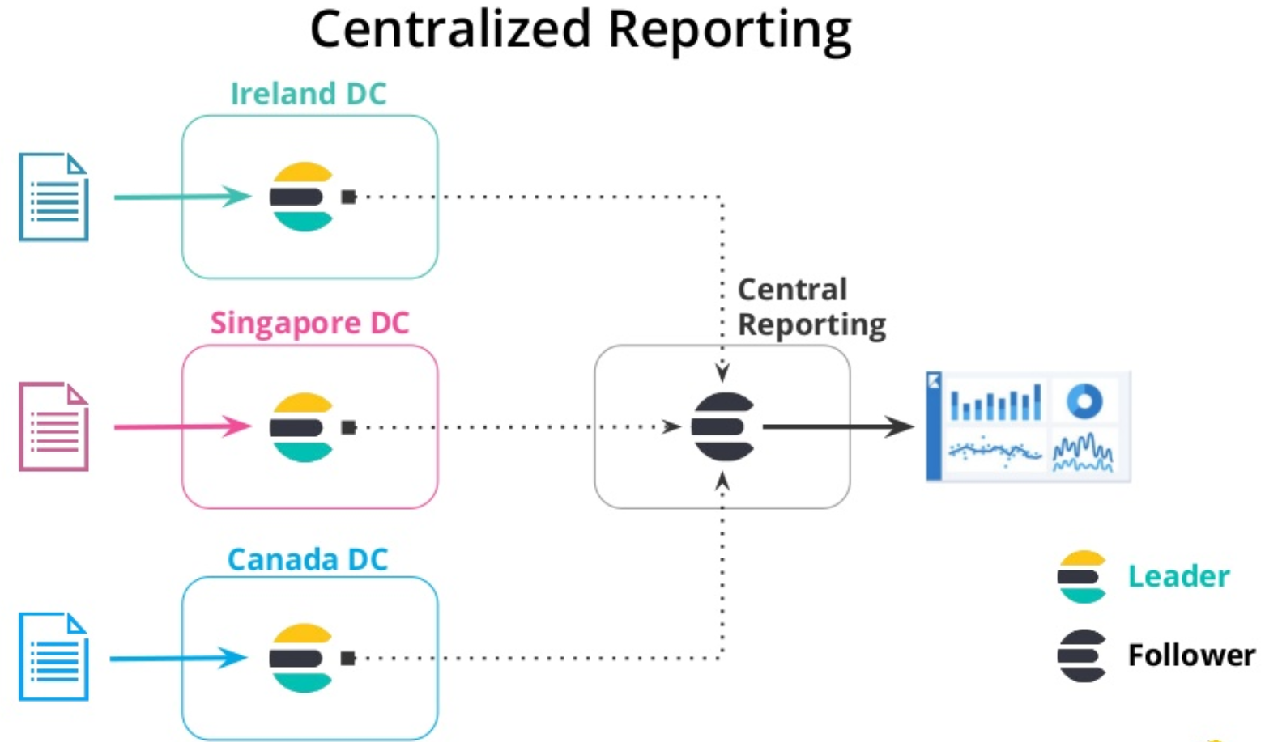
ES translog：

